Slide 1
New Zealand
Whale Watch Kaikoura Community Based Ecotourism
Stephen L. Wearing, Paul A. Cunningham

Slide 2
Learning Outcomes
After completing this case study learners should be able to understand:
the way local ecotourism tourism ventures can meet the varying demands of sustainability, in terms of the way this term is conceived, applied and implemented into the management of such enterprises;
the scope and scale of the economic, social, cultural and biophysical impacts of whale watching as a tourism activity in a variety of contexts;
the relationship between whaling, whale-watching tourism and the natural environment; and
the policies and industry-based initiatives related to whale watching as a sustainable tourism activity.

Slide 3
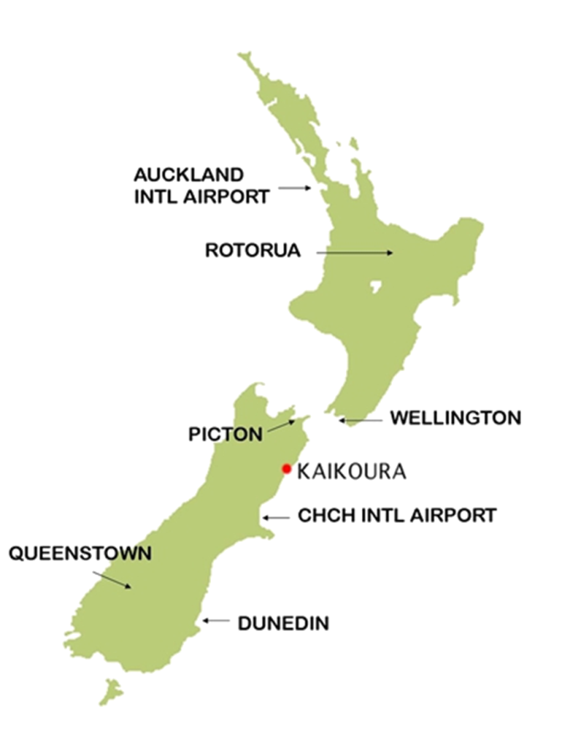
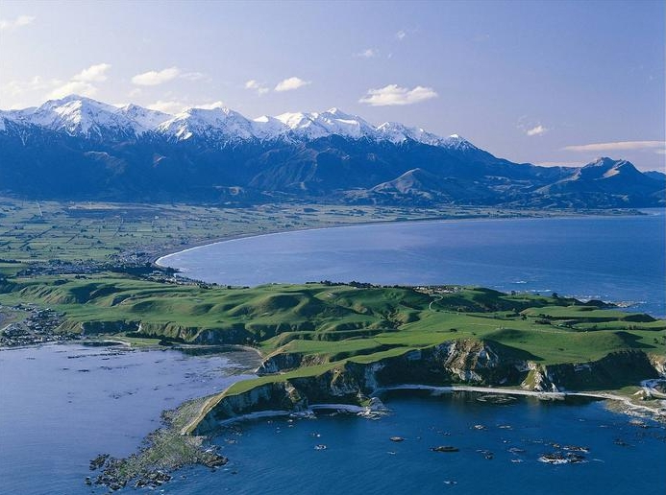
Background
This case study examines how ecotourism can provide sustainable lifestyles for local communities who are willing to change and integrate nature into their values.

Slide 4
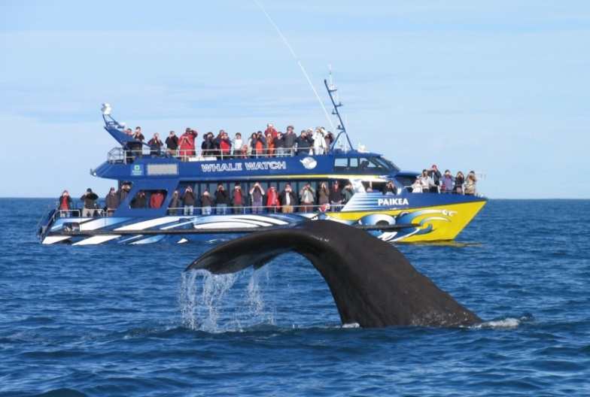
Background
It also demonstrates the scope and scale of the economic, social, cultural and biophysical impacts of whale watching as a community based tourism activity in a variety of contexts
It explains the relationship between whaling, whale-watching tourism and the natural environment and how natures value can be transposed through community based ecotourism
It explains the policies and industry-based initiatives related to whale watching as a sustainable tourism activity and in particular looks at the Kaikoura case study as a best practice example.

Slide 5
Key Concepts
Ecotourism
Triple Bottom Line (TBL) in community based development
Benchmarking in sustainable tourism
Economic sustainability for local communities
Sustainability and the ‘tragedy of the commons’

Slide 6
Future Outlook
Many community-based ecotourism operators are now working within a new politico-economic space, created by the shared language of ‘sustainability’ and a more mainstream environmental agenda.
Whale Watching has enabled many ocean resource depend communities to reposition nature where it is a means to revitalise that “interdependency and extend the human-biosphere relationship” in new directions.

Slide 7
Study Questions
Discuss how a community-based tourism organisation such as WWK is acting sustainably. Provide reasons and examples to support your answer.
What evidence does Orams (2001) provide for the case under study? Give reasons and examples to support your answer.
In the debate on whaling versus whale watching, should cultural rights be prioritised over animal rights within the context of sustainable tourism? Give reasons and examples to support your answer.
Read Lawrence and Phillips (2004) and outline the discourse that led to an evolution from whaling to whale watching at this location. Is the main reason for this change related to an economic return or are there other factors?
Provide an outline of sustainable practice that can be used in whale watching to ensure that it does not impact on the whales.

